Slide 1
Thermal Images
Samantha Fleming & Zach Culp

Slide 2
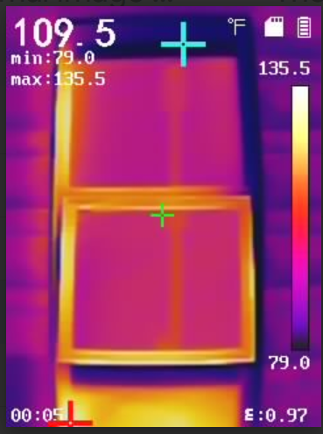
Purpose
Collect additional thermal images of windows and doors on campus
Using statistical or data science methods, create an algorithm that will clean images automatically
Any additional statistical insights

Slide 3
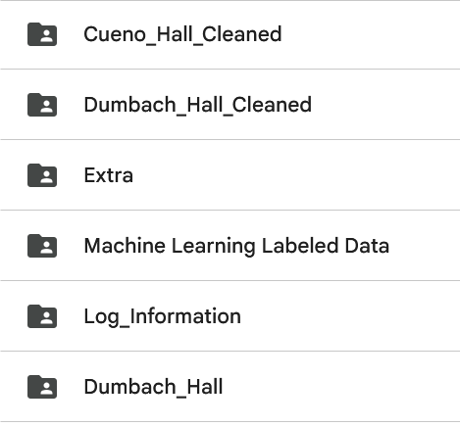
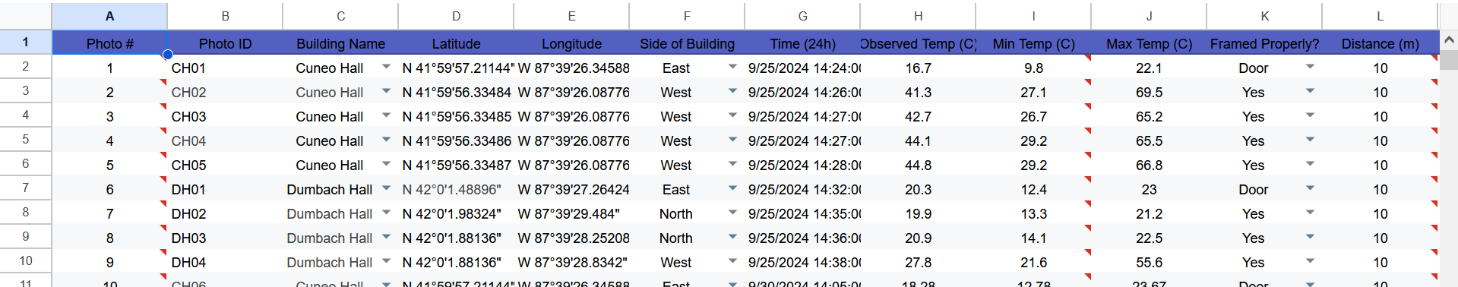
Previous Works
Created a database containing the data collected including photo ID, building name, side of building (ex. North), date/time, temperature, distance (fixed at 10 meters), floor level, image framing quality, and interior/exterior
Used machine learning algorithms to detect heat anomalies in building windows.

Slide 4
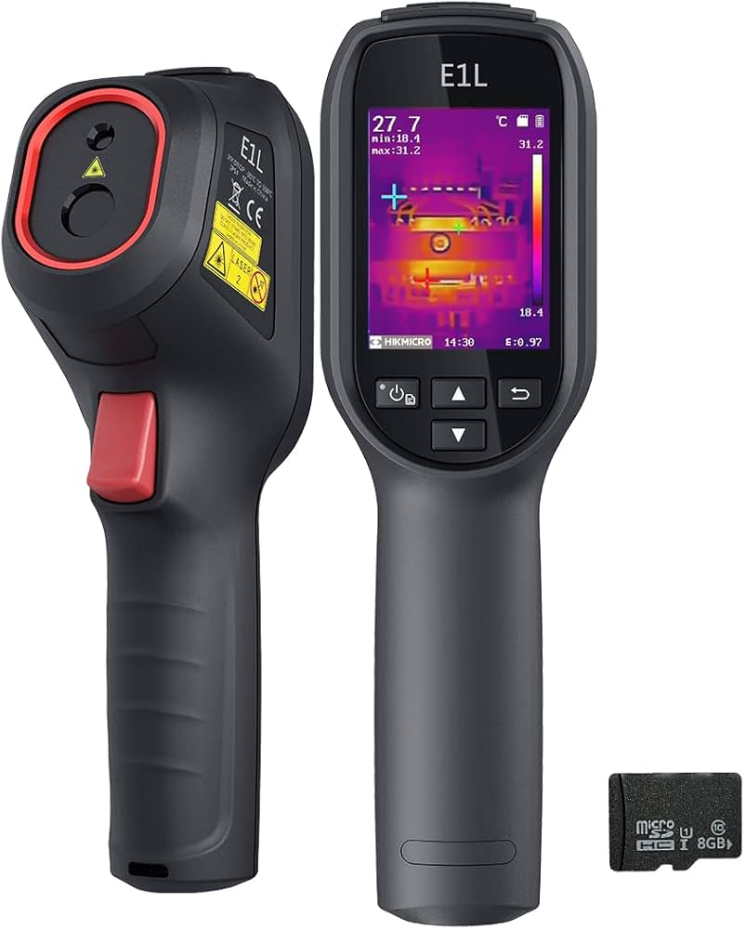
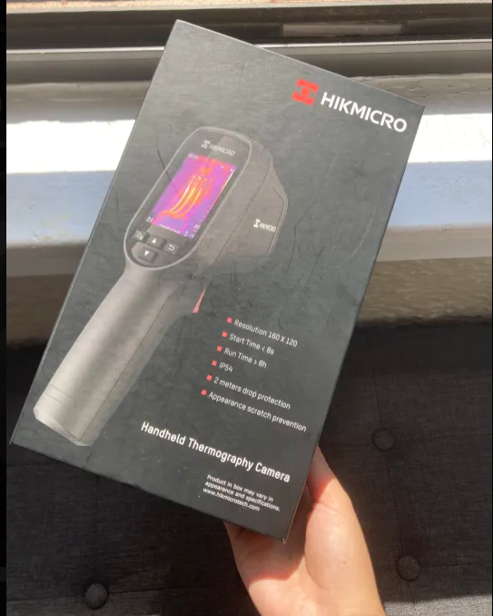
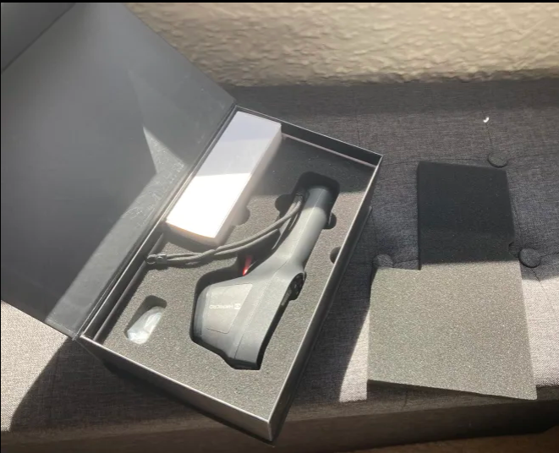
Thermal Camera
Thermal cameras measure temperature at each pixel and display the results as a heat map showing how temperatures vary across the surface.
Temperature may be in Fahrenheit or Celsius

Slide 5
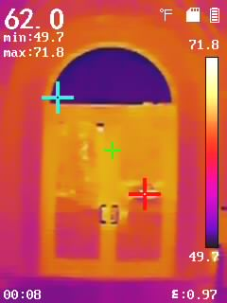
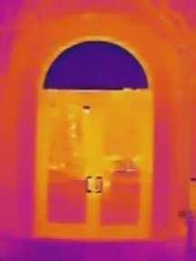
Image Cleaning

Slide 6
Interface Description
Real-time Center Temperature
Min. Temperature Display
Color-Temperature Scale
Max. Temperature Display
Emissivity
Notes:
Emissivity - its effectiveness in emitting energy as thermal radiation.

Slide 7
Limitations & Potential Issues
We want to compare older and newer buildings on campus, but some of the newest (Environmental Science building) have coatings too efficient
Therefore, only Cuneo and Dumbach are the buildings that we are working with
Reflections or shadows may impact the temperature readings, creating unwanted noise.
The overall number of images is lower than desired

Slide 8
Next Steps
Start taking pictures around Cuneo and Dumbach Hall to add to the database
Begin creating the algorithm to detect and clean the images

Slide 9
Questions?

